Slide 1
Improving Search Relevance for Short Queries in Community Question Answering
Date： 2014/09/25
Author ： Haocheng Wu, Wei Wu, Ming Zhou, Enhong Chen, Lei Duan, Heung-Yeung Shum
Source： WSDM’14
Advisor: Jia-ling Koh
Speaker： Sz-Han,Wang

Slide 2
OUTLINE
INTRODUCTION
METHOD
USER INTENT MINING
MODELS
EXPERIMENT
CONCLUSION

Slide 3
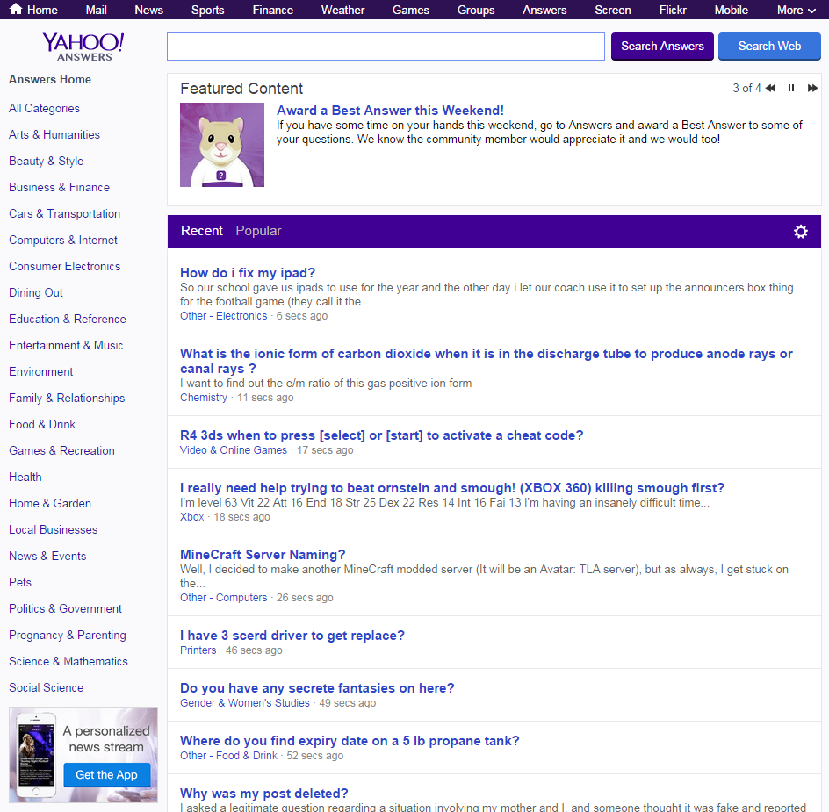
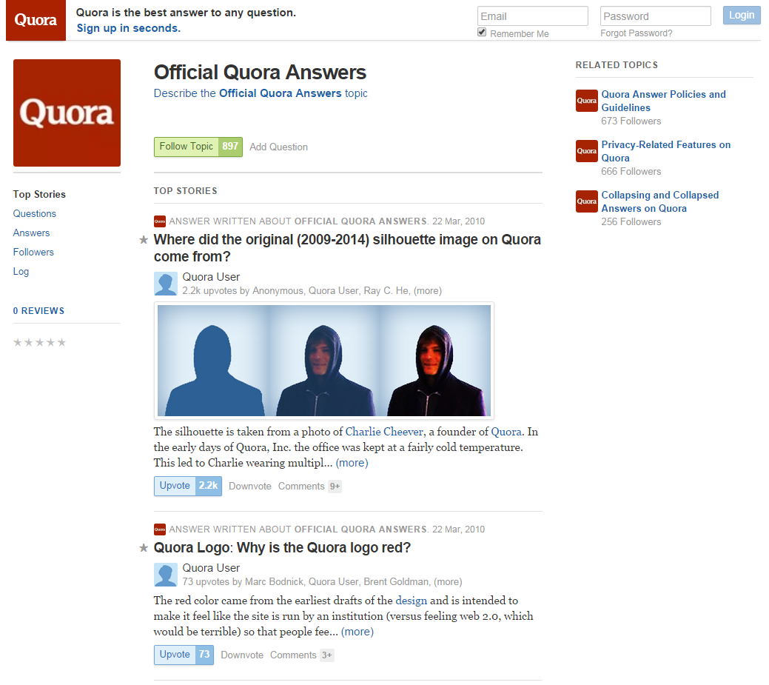
INTRODUCTION
Community question answering
How to leverage historical content to answer new queries?
YAHOO!ANSWER
Quora

Slide 4
INTRODUCTION
Existing methods usually focus on long and syntactically structured queries.
When searching CQA archives, users influenced by web search are used to issuing short queries.
On many CQA sites, the search results are not satisfactory when an input query is short.

Slide 5
INTRODUCTION
Goal:
Improve search relevance for short queries in CQA question search.
How to improving search relevance?
Propose an intent-based language model by leveraging search intent that is mined from question descriptions in CQA archives, web query logs, and web search results.

Slide 6
OUTLINE
INTRODUCTION
METHOD
USER INTENT MINING
MODELS
EXPERIMENT
CONCLUSION

Slide 7
USER INTENT MINING
Mining user intent from three different sources:
(1) question descriptions in CQA archives
(2) web search logs
(3) the top search results from a commercial search engine

Slide 8
Intent Mining from CQA Archives
Reveal an asker’s specific needs for a question
Example:
Question: Why do you love Baltimore?
Description: Maryland、Charm City

Slide 9
Intent Mining from CQA Archives
Extract intent from the descriptions:
Predict user intent for short queries
given a short query q
relevance score
rank terms by Pcqa(t|q)
Get the intent word set W = {(t, ϕ)} from CQA archives
Term to term translation model
P(e | a) P(e | b) P(e | c) P(e | d)
P(f | a) P(f | b) P(f | c) P(f | d)
Source-Question
a b c d
Target-Description
e f

Slide 10
Intent Mining from Query Log
Conveys common preferences about the query
Example:
Query: Beijing
Top intent : travel
Most searchers of “Beijing” are interested in travel guides

Slide 11
Intent Mining from Query Log
Extract intent from both the queries and URLs:
given a query, collects queries that share the same suffix or prefix and aggregates the co-clicked URLs of these queries
queries and URLs are clustered based on word overlap and the similarity of co-click patterns
Merge the terms from queries and URLs to get the intent word set W = {(t, ϕ)} from query log

Slide 12
Intent Mining from Web Search Results
Contain popular subtopics related to the query
Example:
Apple just announced the “iPhone 6”
Query: iPhone
Questions about the new product may be more attractive than those about “iPhone 5”

Slide 13
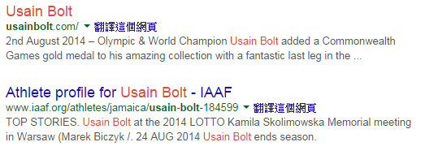
Intent Mining from Web Search Results
Extract popular intent for short queries from the top search results
Given a query
Crawl the newest search results
Parse URLs, titles, and snippets
Form an intent candidate set
Calculate the intent final score
intent final score=$α$BM25(t,h,H)+$β$BM25(t,s,S)+$γ$BM25(t,u,U)
Rank intent based on the final score
Get the intent word set W = {(t, ϕ)} from web search results
title
URL
snippet

Slide 14
MODELS
Language Model for Information Retrieval
Translation-based Language Model
Translation-based Language Model plus answer language model

Slide 15

MODELS
Intent-based Language Model
intent from source i is Wi = {(t_{ij}, ϕ_{ij} )}, 1$≤$i$≤$3, 1$≤$j$≤$N

Slide 16
OUTLINE
INTRODUCTION
METHOD
USER INTENT MINING
MODELS
EXPERIMENT
CONCLUSION

Slide 17
EXPERIMENT
Data set
Collected a one-year query log from a commercial search engine and randomly sampled 1,782 queries

Slide 18
EXPERIMENT
For each sampled query, retrieved several candidate questions from the indexed data
Recruited human judges to label the relevance of the candidate questions regarding the queries with one of four levels: “Excellent”, “Good”, “Fair”, and “Bad”.

Slide 19
EXPERIMENT
Evaluation results on Yahoo data and Quora data

Slide 20
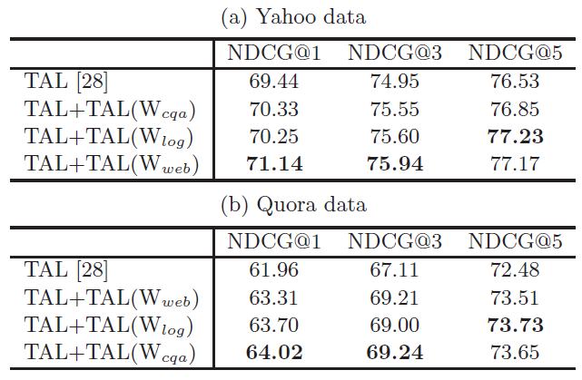
EXPERIMENT
Evaluation results of different intent models

Slide 21
OUTLINE
INTRODUCTION
METHOD
USER INTENT MINING
MODELS
EXPERIMENT
CONCLUSION

Slide 22
CONCLUSION
Propose an intent-based language model that takes advantage of both the state-of-the-art question retrieval models and the extra intent information mined from three data sources.
The evaluation results show that with user intent prediction, our model can significantly improve state-of-the-art relevance models on question retrieval for short queries.

